Slide 1
A grassroots civic voice
An effective network
Supporting communities
A channel for information
A voice of scrutiny

Slide 2
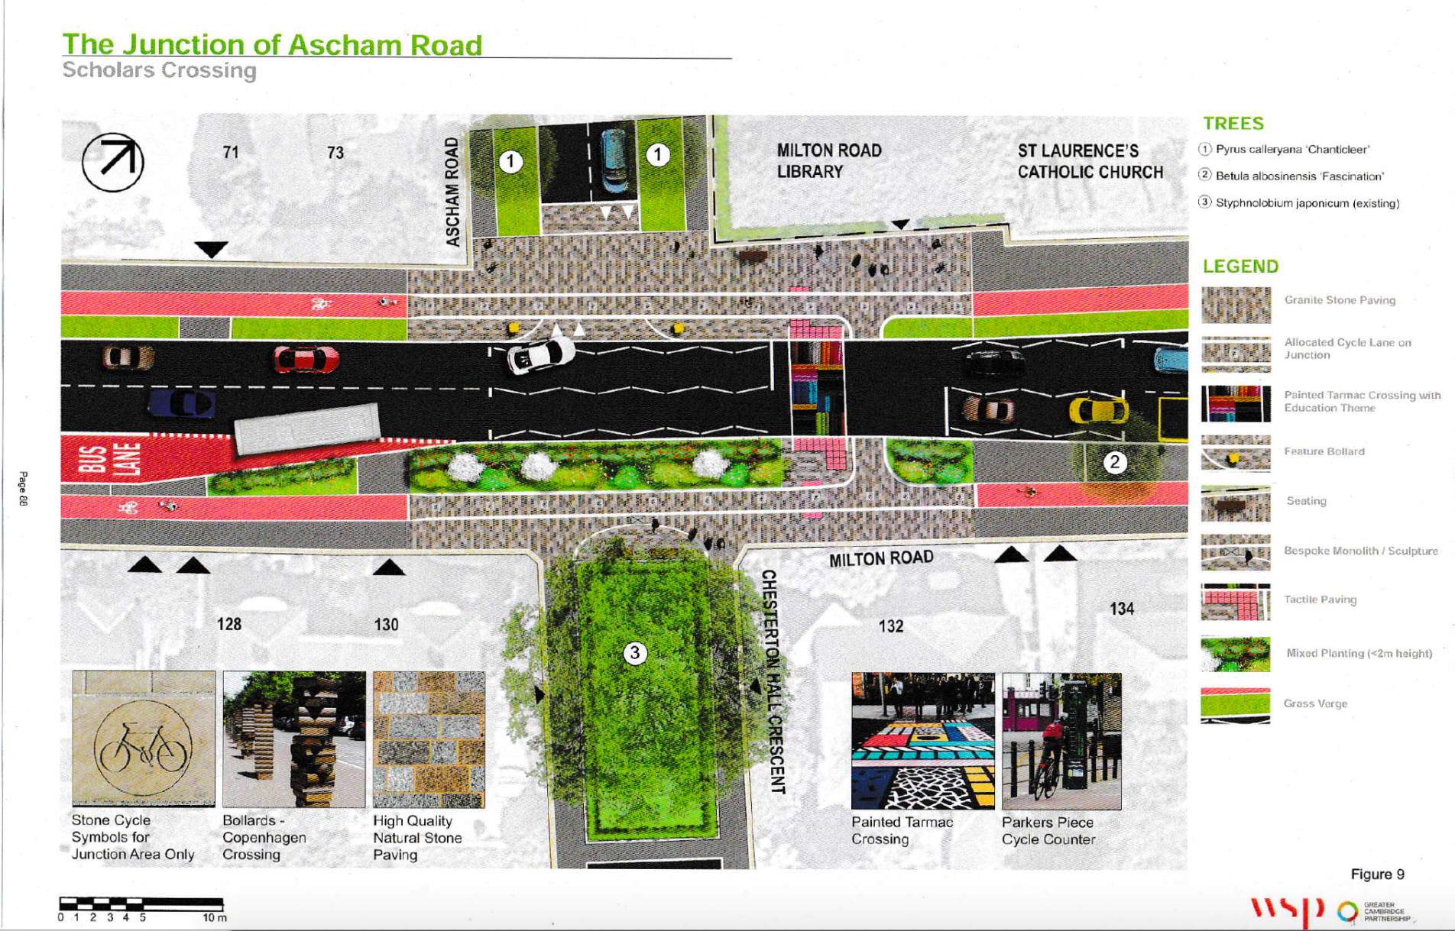
Milton Road Landscaping Plans

Slide 3
Arbury Hedge Taking a Stand

Slide 4
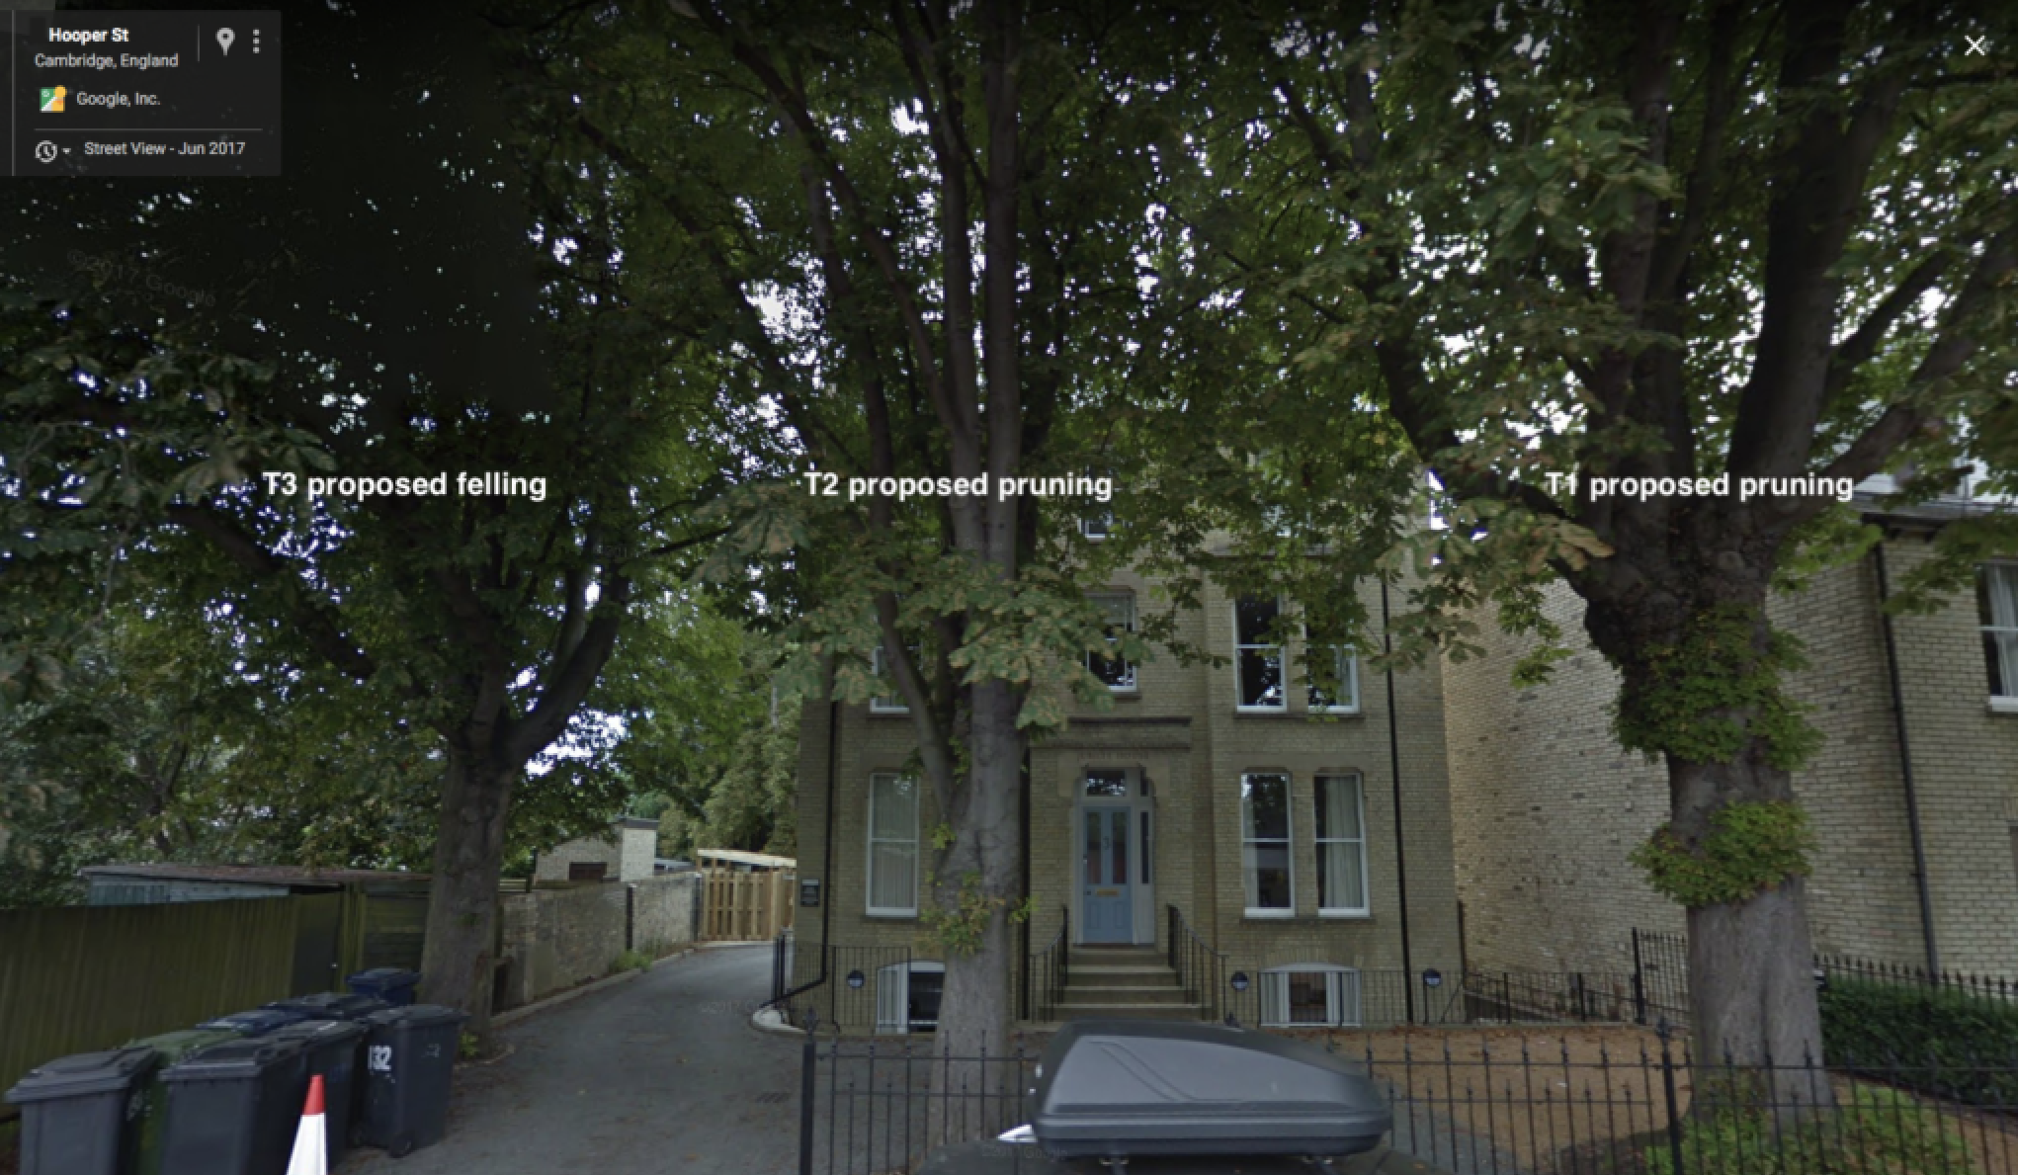
Hooper Street Chestnut trees saved!

Slide 5
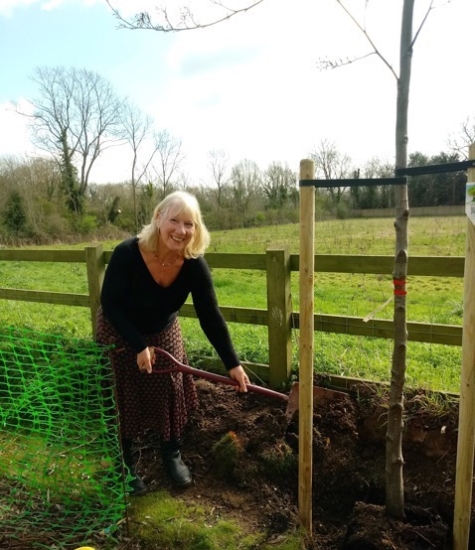
Grantchester Meadows Replacement planting
Residents were able to achieve a good outcome for the Grantchester footpath

Slide 6
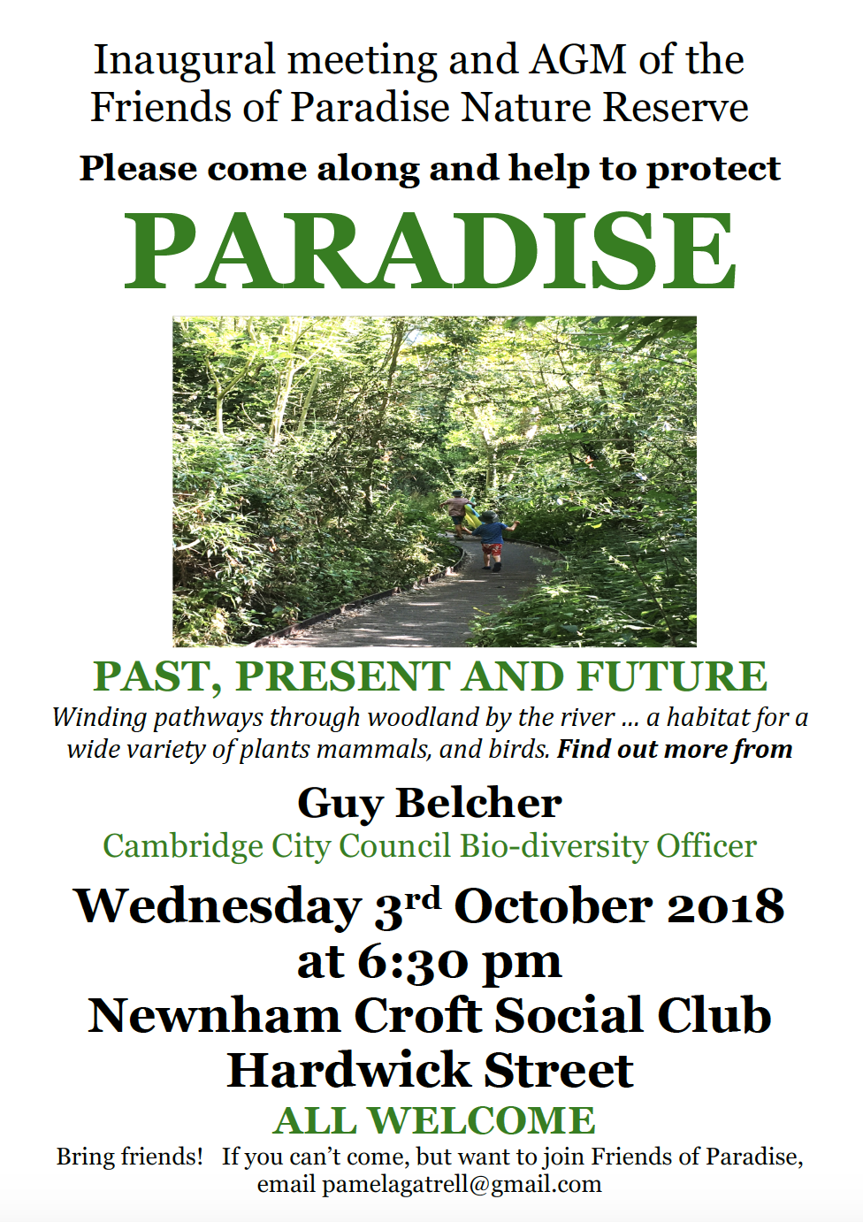
Biodiversity
West Cambridge residents have set up the Friends of Paradise Nature Reserve

Slide 7
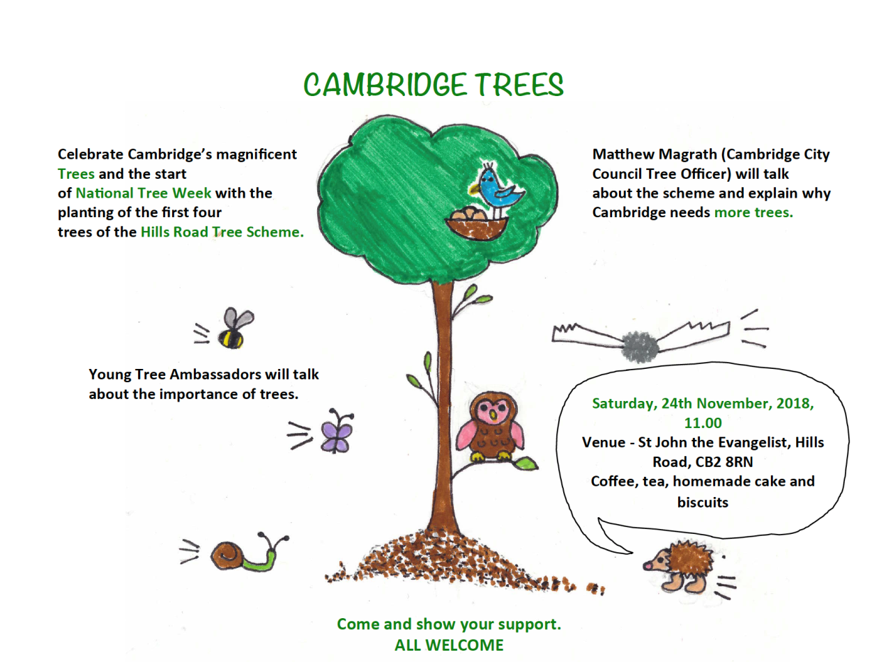
Cambridge school children are taking the lead

Slide 8
www.fecra.org.uk View filmed meetings on the FeCRA YouTube channel Sign up as an individual to the FeCRA Mailing List Join your Residents’ Association With FeCRA support, consider starting an RA Support filming and meetings by donating generously THANK YOU! wendy.blythe.fecra@gmail.com

